Slide 1

Project 4: Machine LEARNING integration
UNDERWRITERS: Shailesh Godkhindi, Nazih Bouanani, Rajeswari Natchiappan, Corey Chickowski

Slide 2

Project Goal
Create a machine learning model that analyzes loan applications and predicts loan approval based on features of the applicants credit.

Slide 3
Sources and Technologies
Data source: https://www.kaggle.com/c/home-credit-default-risk/data
Tools and Libraries:
Python Pandas
Scikit-learn
Python Matplotlib
Flask
HTML/CSS
Host application:
Heroku and Ngrok

Slide 4
Machine Learning Overview
Gather and Prepare Data for Machine Learning
Test and Choose a Model: Random Forest Classifier
Save model for use in Web Application

Slide 5
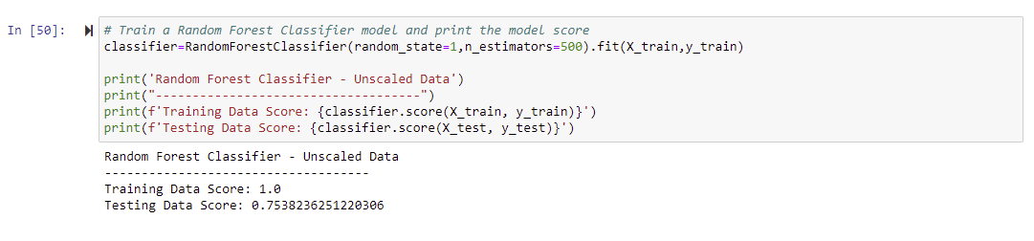
Machine Learning: Model Development

Slide 6
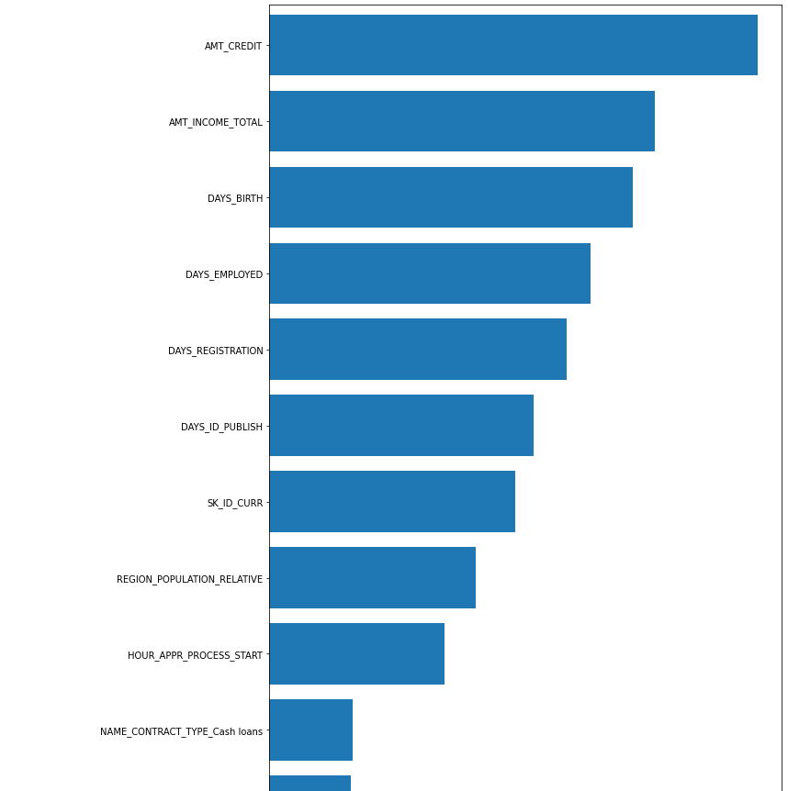
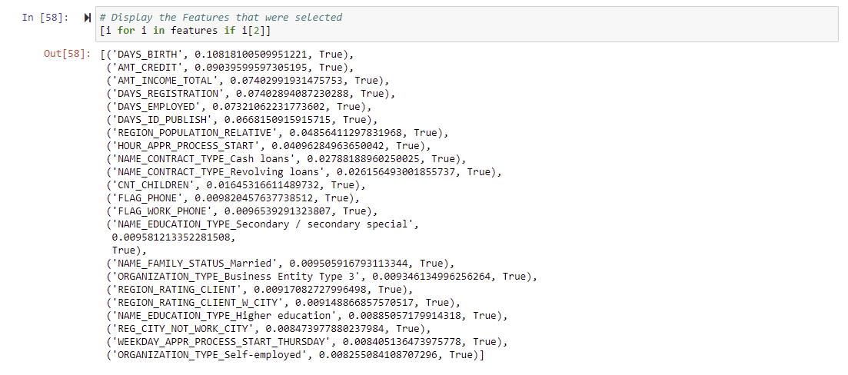
Machine Learning: Model Development

Slide 7
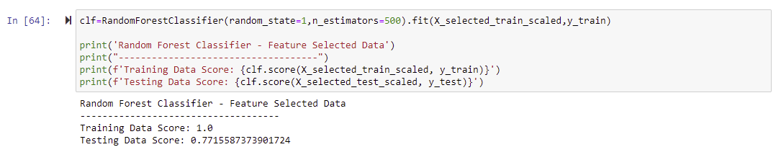
Machine Learning: Model Development

Slide 8
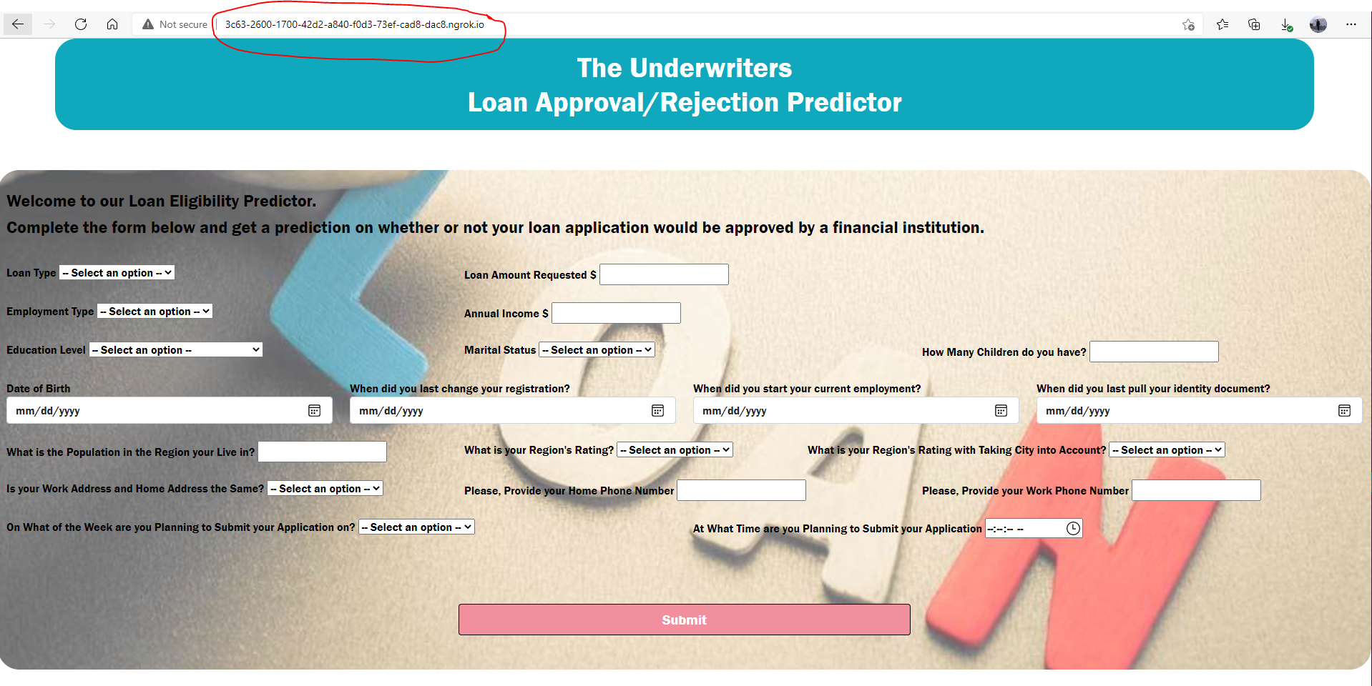
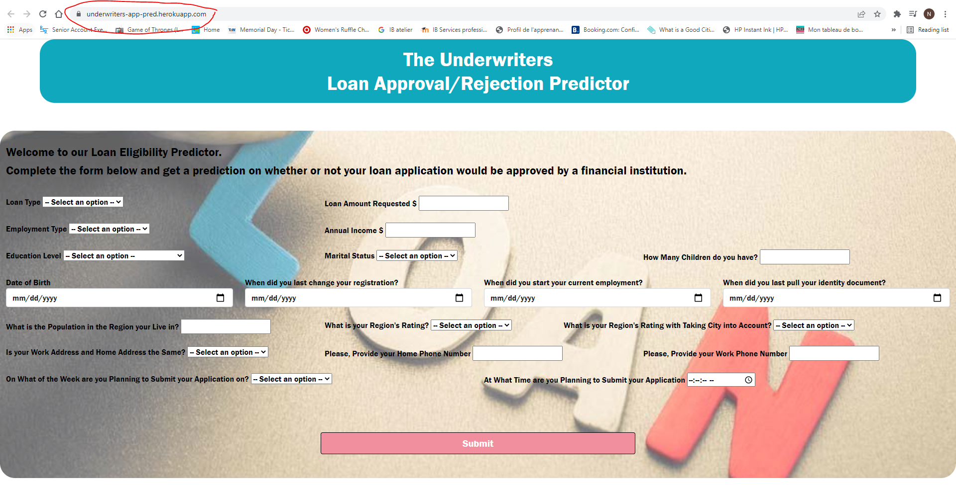
Web application
Utilized Python, HTML, and CSS in conjunction with Flask to launch a local web application
Deployed a live web application using Heroku and Ngrok

Slide 9


DEMO Time

Slide 10
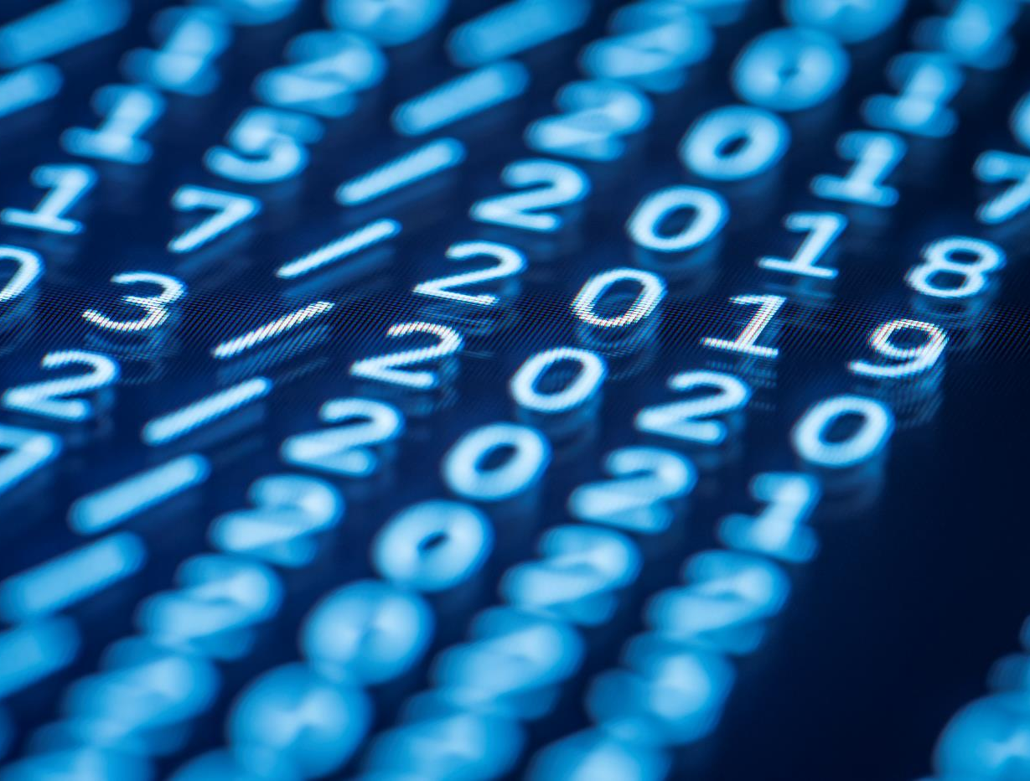
Thank You
Mr. Kelechi and Class for a great 6 months

